Slide 1
FINAL PROJECT LIBRARY MANAGEMENT SYSTEM
Group 6
Chu Quoc Hung
Nguyen quoc huy

Slide 2
OUTLINE
Work assignment
Achieved results
Design patterns used
Application Demo

Slide 3
Work assignment
Chu Quoc Hung (50%):
- Create android project base.
- Add copy, Borrow book use cases (Required).
- Login, logout use cases (Not required).
- Review source code.

Slide 4
Work assignment
Nguyen Quoc Huy (50%):
- Build web service for database communication.
- Add book, Register account use cases (Required).
- Review design and test.

Slide 5
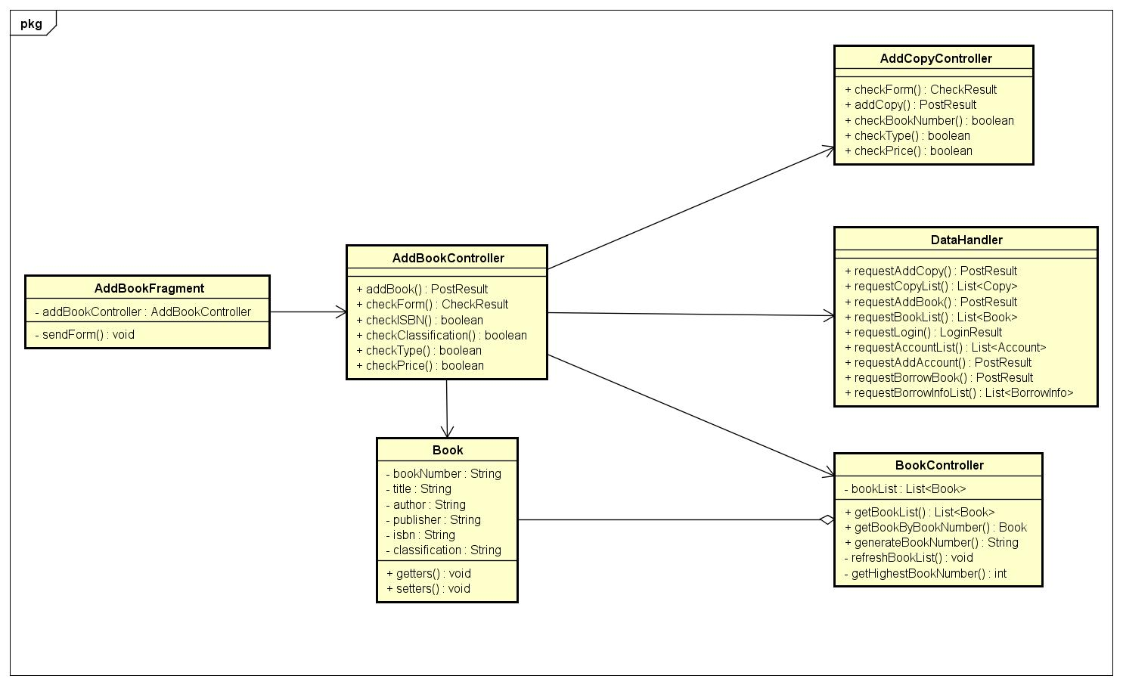
Achieved results

Slide 6
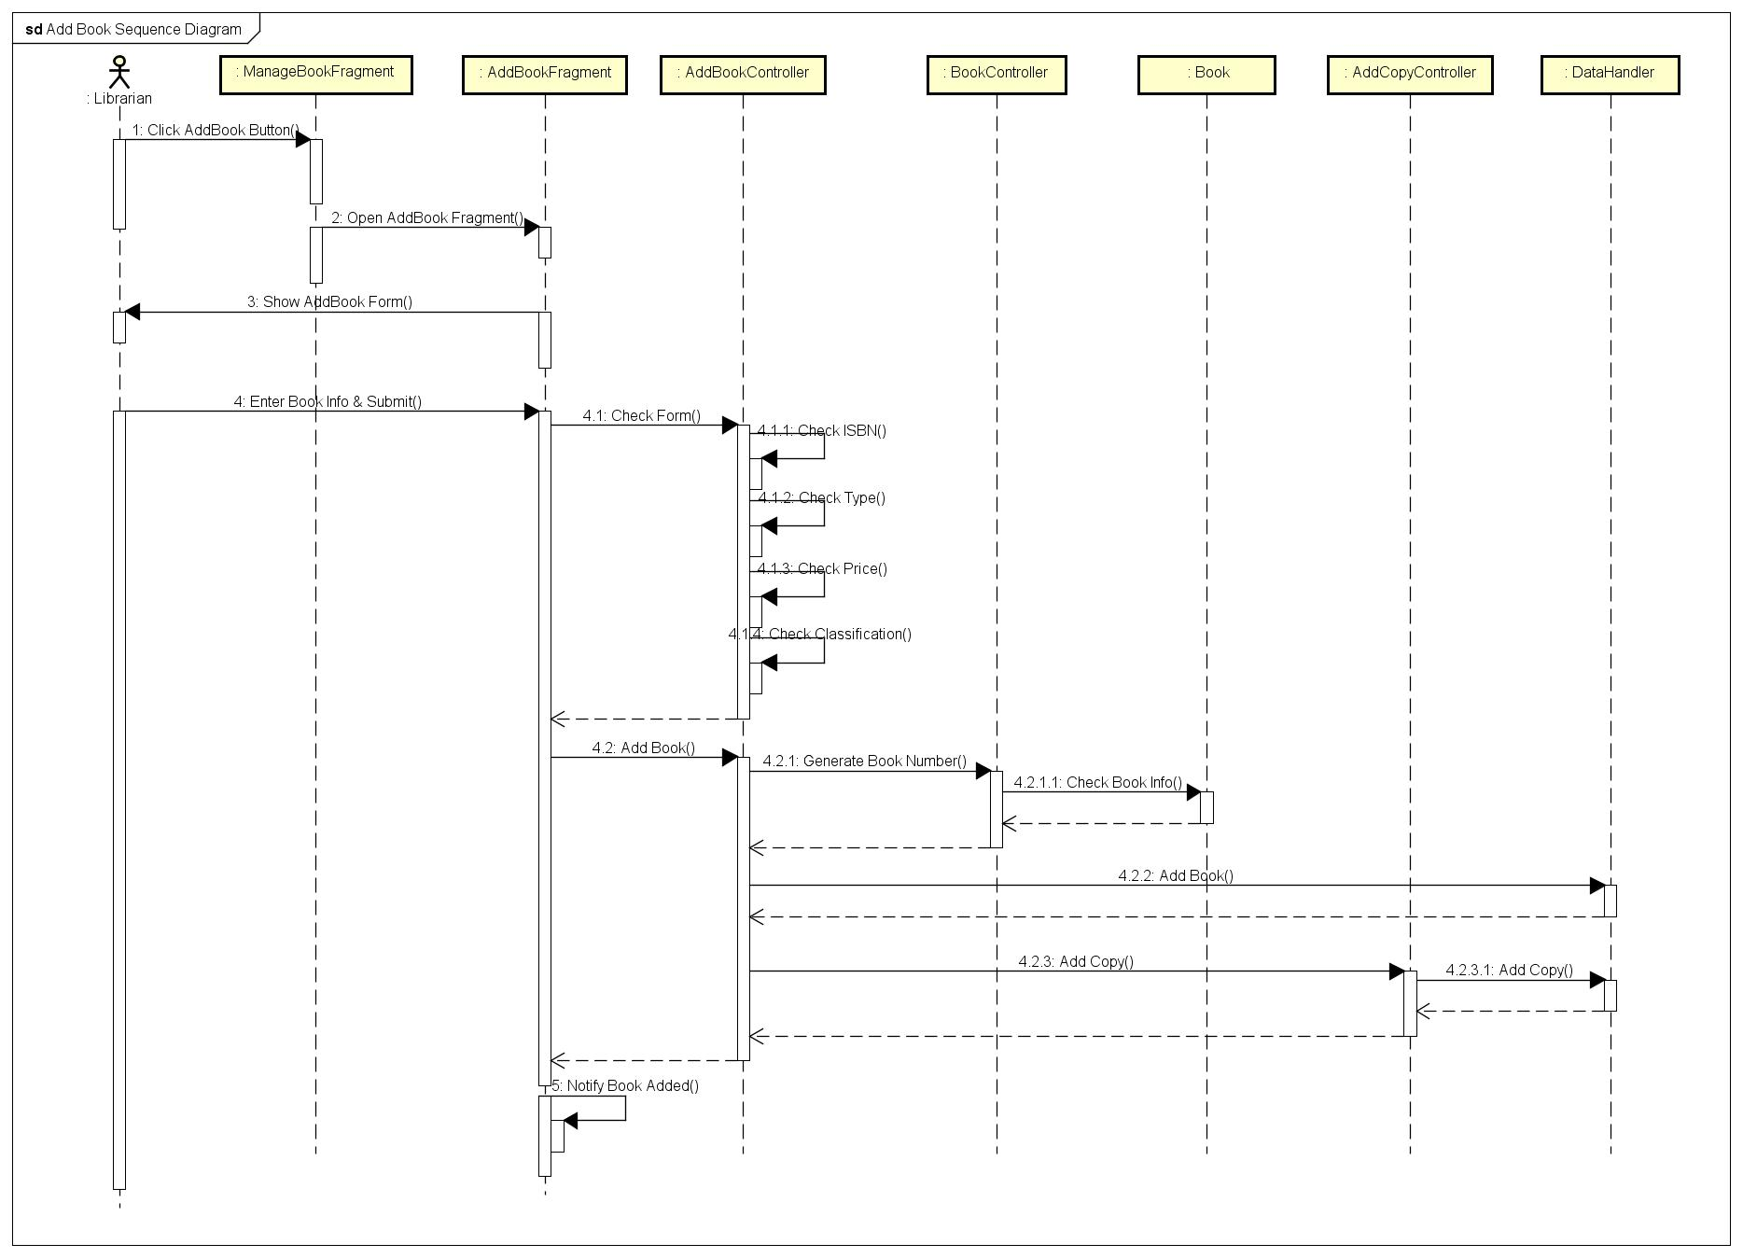
Achieved results

Slide 7
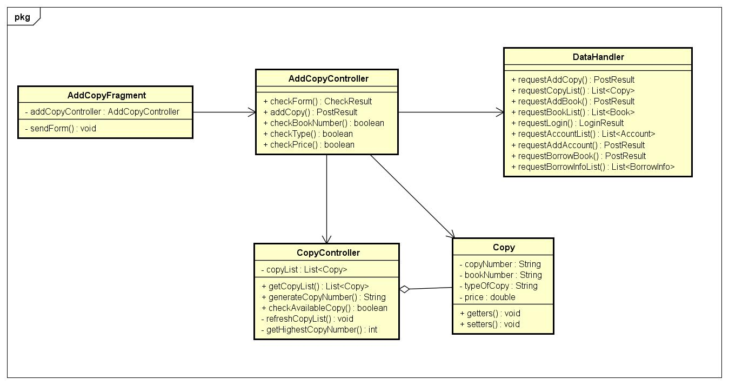
Achieved results

Slide 8
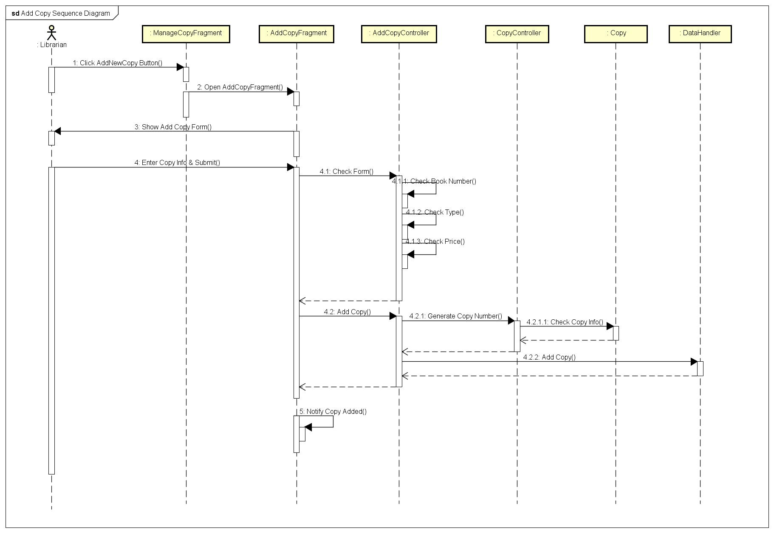
Achieved results

Slide 9
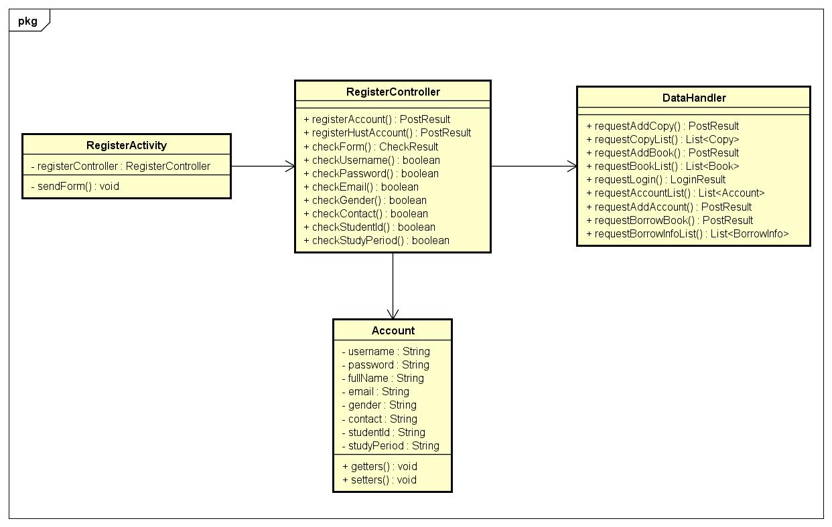
Achieved results

Slide 10
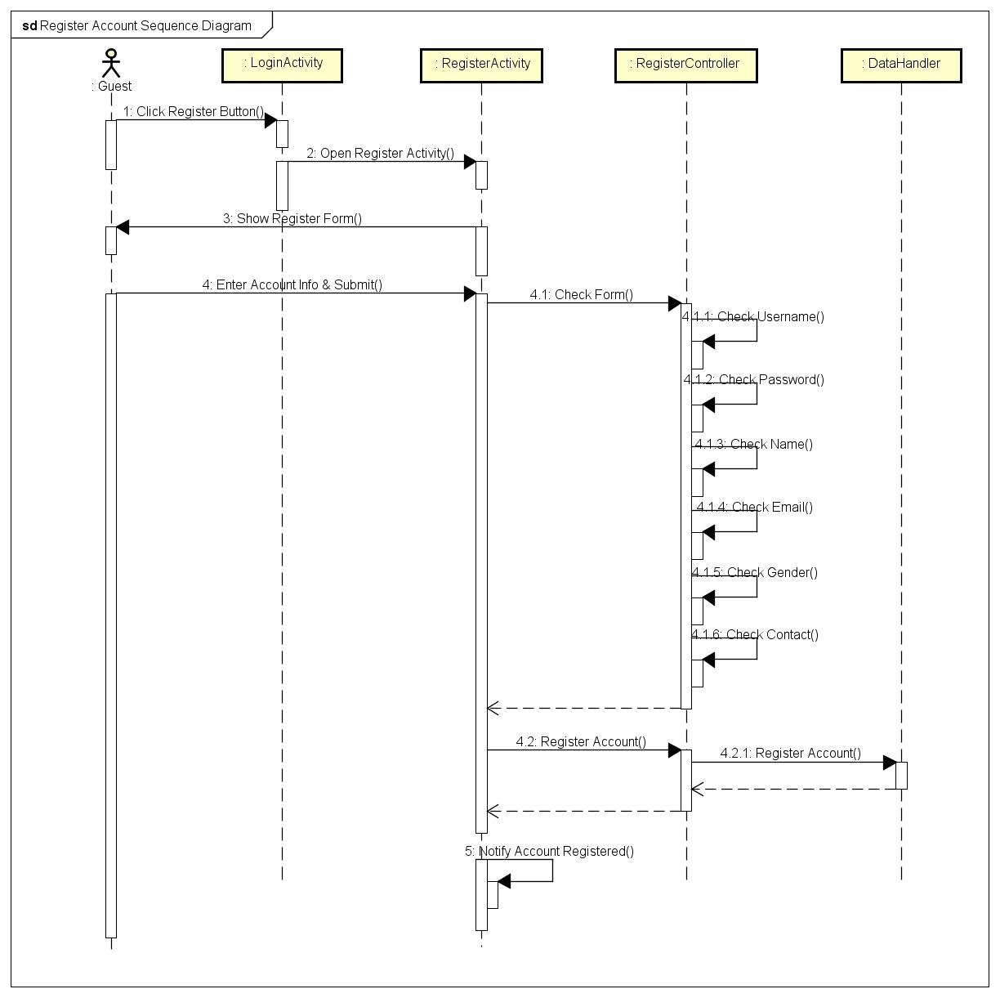
Achieved results

Slide 11
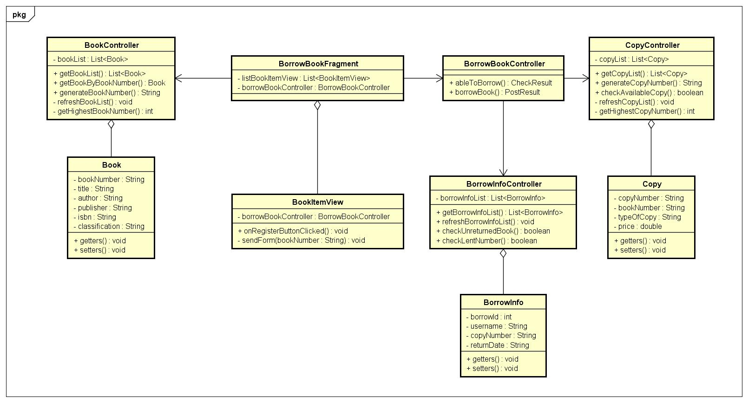
Achieved results

Slide 12
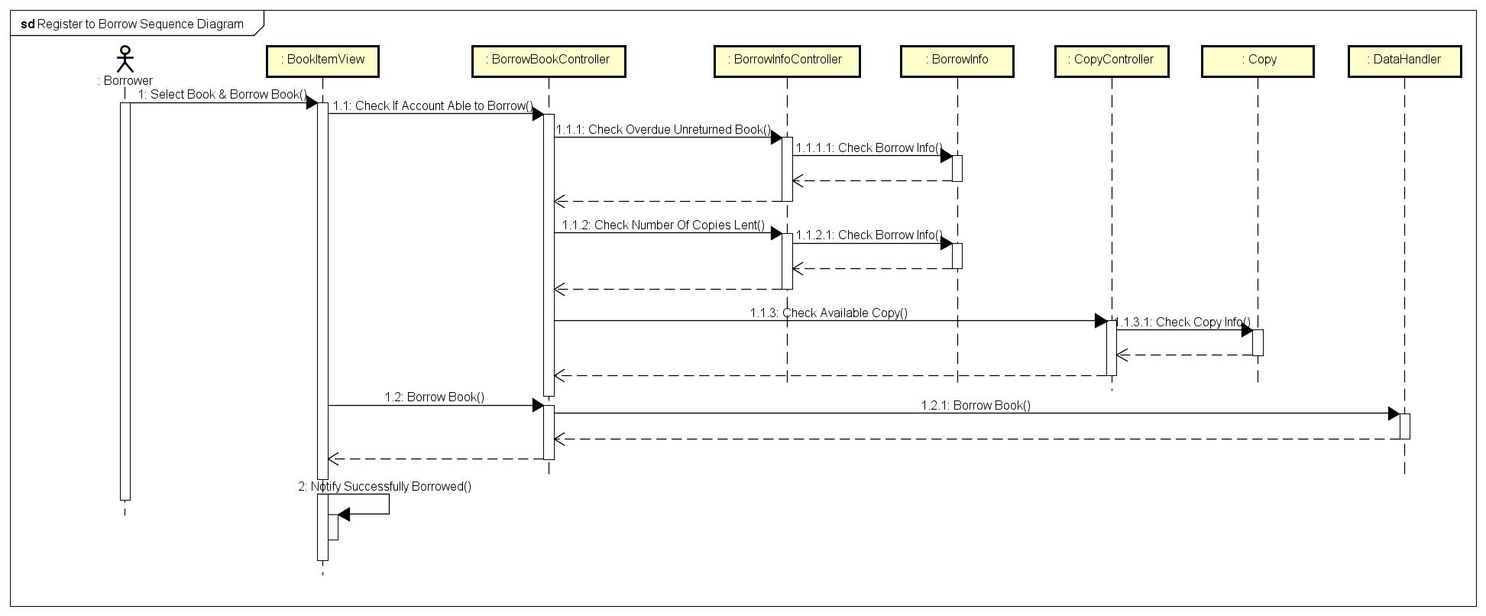
Achieved results

Slide 13
DESIGN PATTERN USED
Observer Pattern
Factory Pattern
Template Pattern
Adapter Pattern

Slide 14
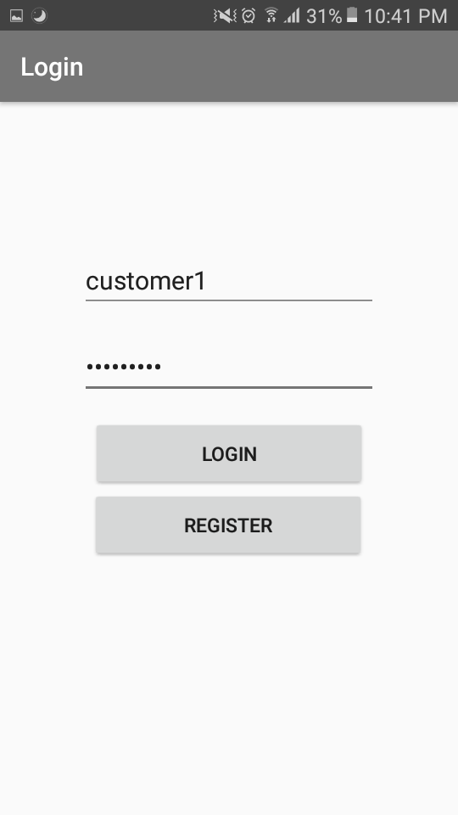
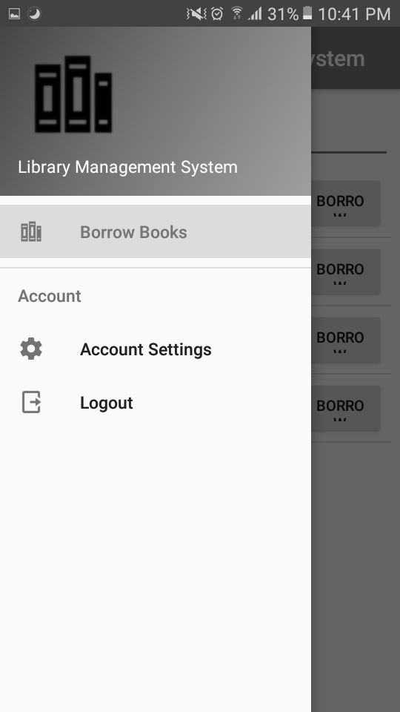
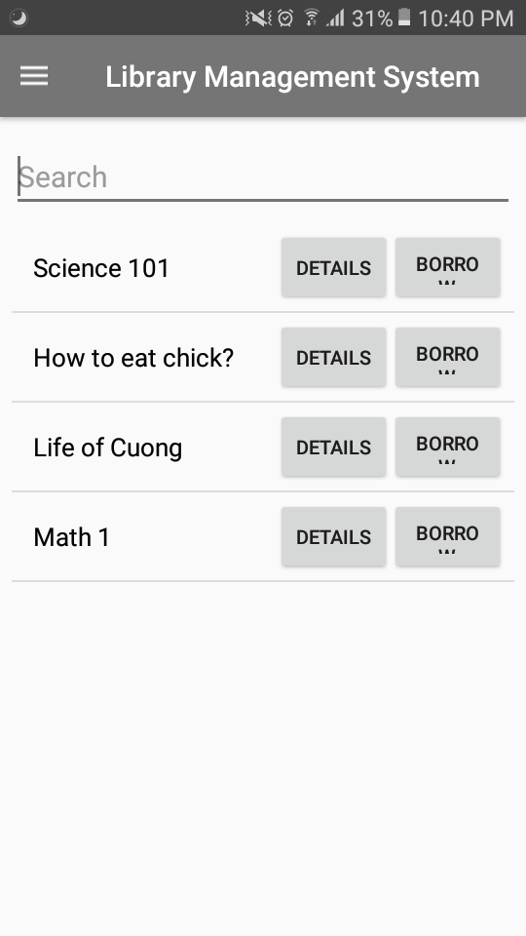
Application Demo

Slide 15
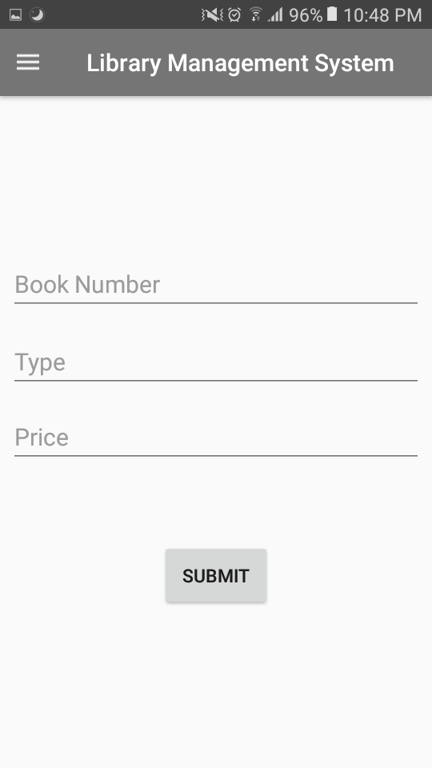
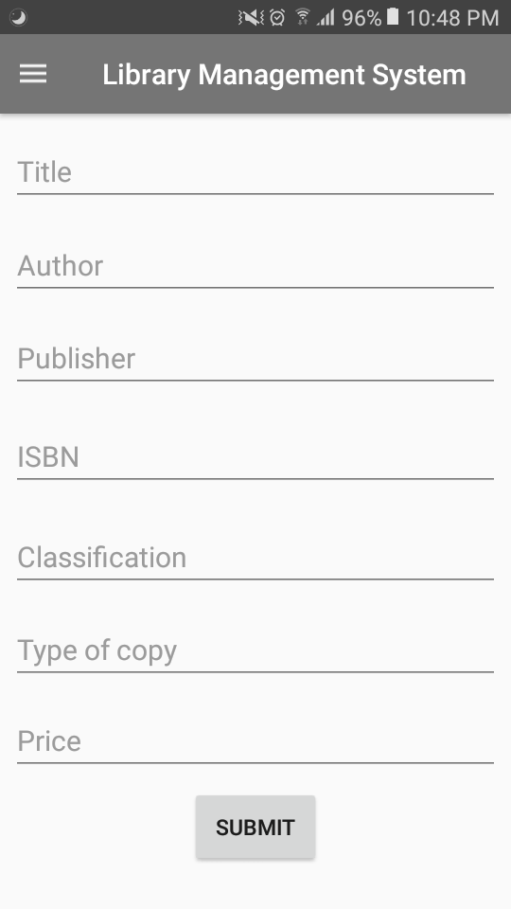
Application Demo

